Slide 1
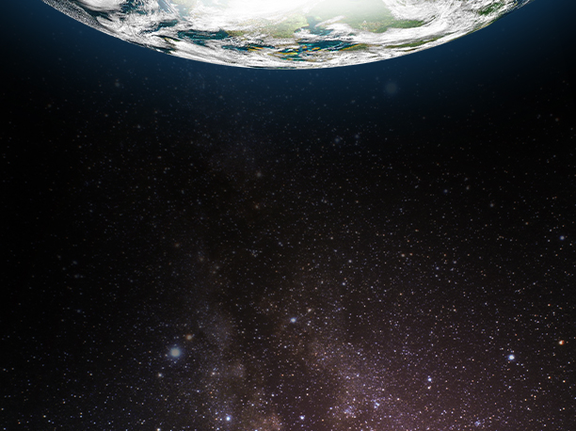

Grant Anderson, President and CEO
The Moon, Asteroids, Mars and Beyond. Designing the Spacecraft Habitat
Arizona NASA Space Grant Symposium, April 15, 2016

Slide 2
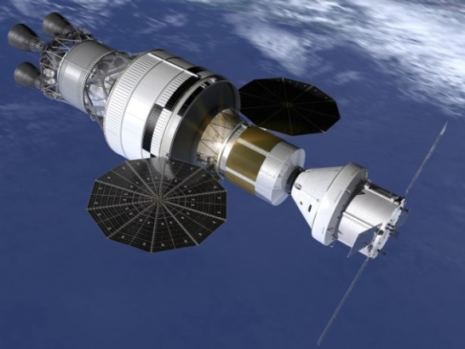
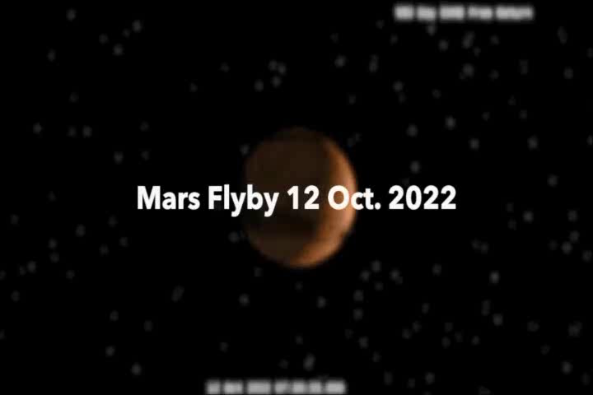
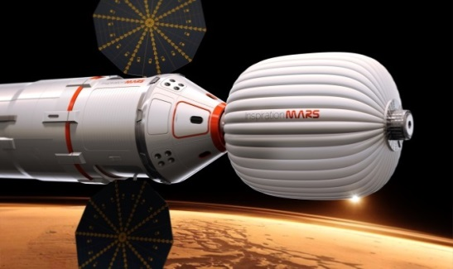
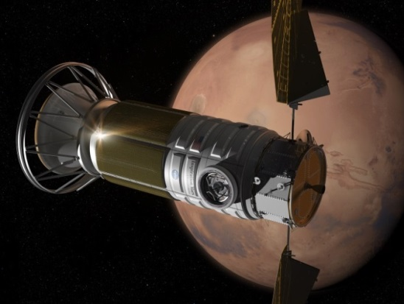
Imagine….
Imagine hearing a crew DESCRIBE their view as they fly by Mars.

Slide 3
Outline
A short history of Habitats
What’s different this time?
Major Drivers for Habitat Design
Drivers effects on Design Choices
What technologies are needed?
Are they available?
Amateurs talk strategy, professionals talk Logistics!

Slide 4
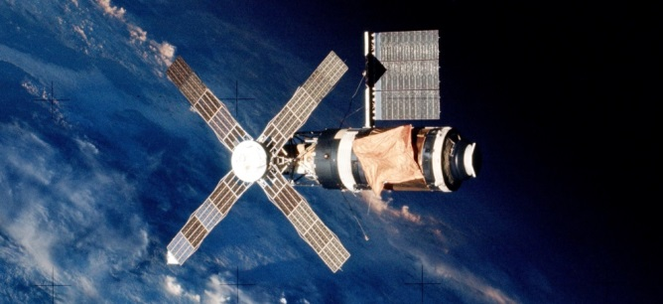
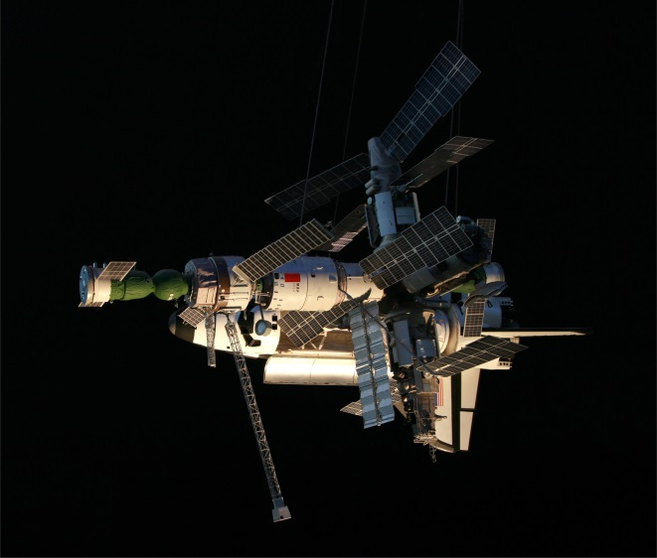
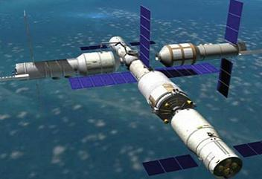
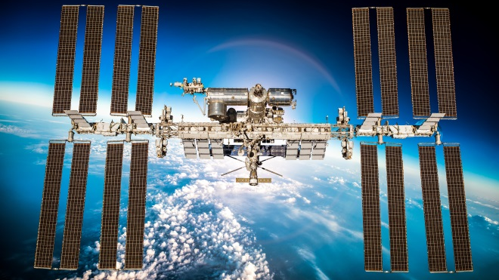
A short history of Habitats
Skylab-Crew 3 Duration Months
LEO,
Earth re-Supply, Escape to Earth, Modular ORUs
MIR-Crew 3
Duration Years
Tiangong-2, Crew 3
Duration Months
ISS-Crew 6
Duration Decades

Slide 5
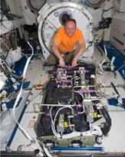
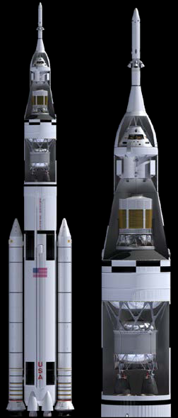
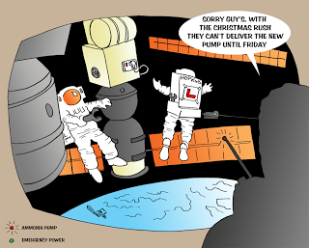
What’s Difference This time?
Maintenance
Replacement by “ORU” is no longer practical
EVA is no longer “routine”
Logistics/Resupply
Spares must be common, small, few
Radiation
GRE/SPE can be intense
Launch Vehicle
SLS, Assembly on orbit

Slide 6
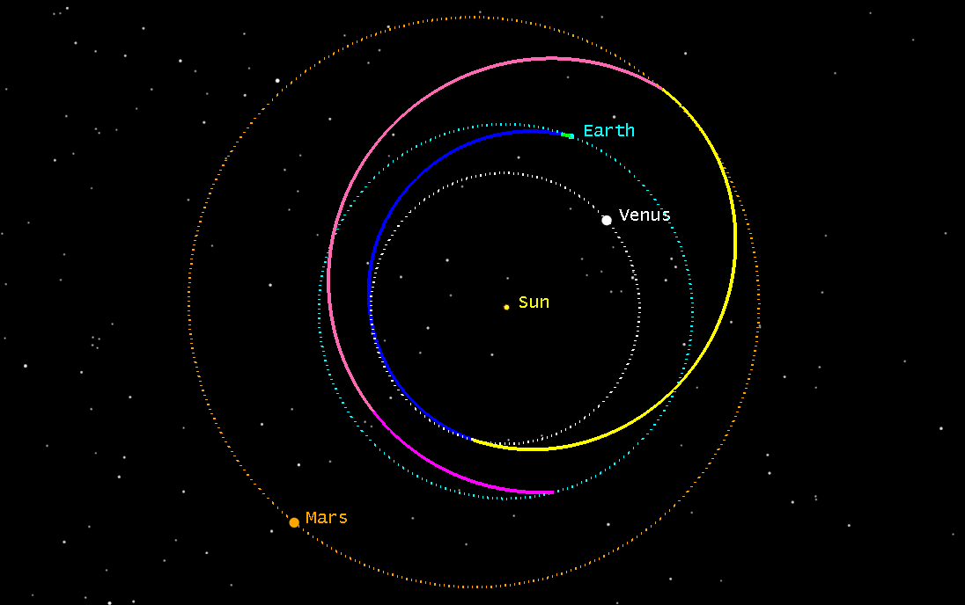
Examples of a Mars Flyby Trajectory
http://www.nasa.gov/sites/default/files/atoms/files/2015_nasa_technology_roadmaps_ta_6_human_health_life_support_habitation.pdf
Crew EVA
Do you really need it?
NOTE: radiation limits 3% rule
Mission Launch

Slide 7
Major Drivers for Habitat Life Support Design
Long-duration drivers
Compared to ISS
Maintenance and Logistics
Radiation: Need a safe haven
Recycling/closure
4 crew persons
ORU’s launched from Earth. 6-8 month manifest/launch cycle
ISS below Van Allen radiation belts
ISS systems down time is excessive for long duration
3-6 persons

Slide 8
Drivers Effects on Design Choices
Design Choice
Comments
ORU/Maintenance at lowest level possible
All critical systems accessible internally
Automation: Limited, smart
4 person crew
An ORU can no longer be a suitcase-sized item. O-rings, board-level electronics
Fluids cannot be toxic, connections easy to make, reliable
Simple manual beat complex automation every time.
Sleeping arrangements.

Slide 9
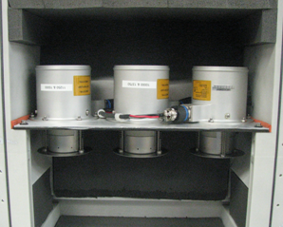
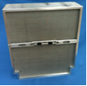


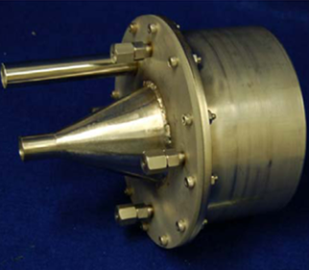
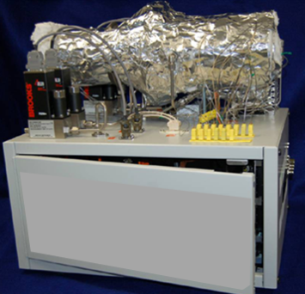
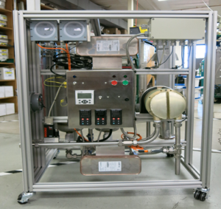
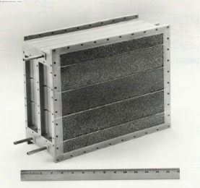
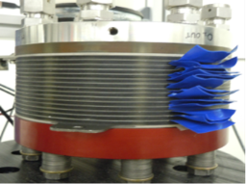
Technology Solutions? Air Management
Air Revitalization Function
Air Circulation
Air Particulate Removal
Trace Contaminant Removal
Post-Fire Atmosphere Recovery
Carbon Dioxide Removal
Carbon Dioxide Reduction
Air Temp and Humidity Control
Oxygen Production
All of these technologies have been operated in Paragon’s and other human spaceflight contractors labs within the last 5 years.

Slide 10
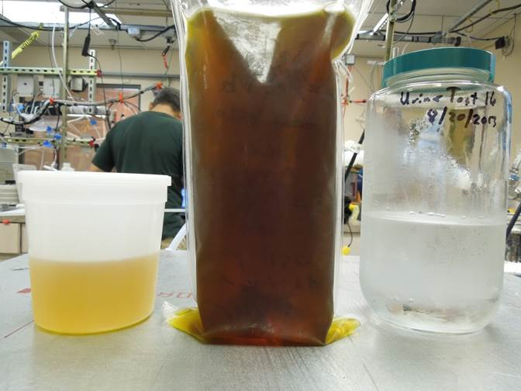
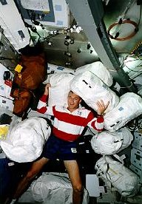
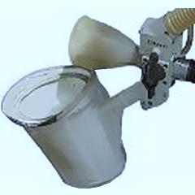
Technology Solutions? Water Management, Food and Waste
Water Management Function
Primary water processor
Urine processor
Water storage
Water quality monitor
Food and Waste Function
Food management and processing
Crew Waste System-short term

Slide 11
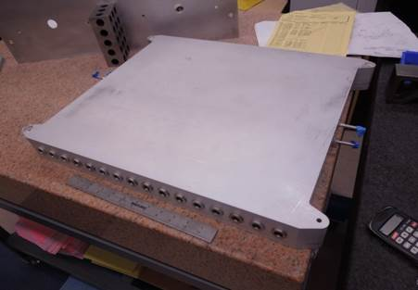
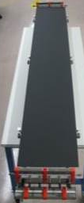
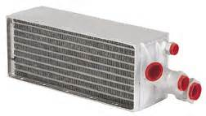
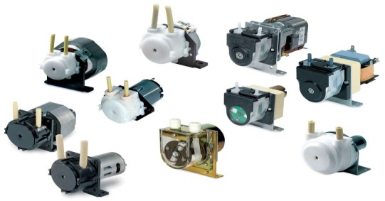
Technology Solutions? Thermal Control
Thermal Control Function
Heat collection
Heat rejection
Heat transport
Court: Lytron

Slide 12
Technology Solutions? Crew Systems
Crew System Function | Technology
Personal provisions | Limited clothing, sleep systems, personal hygiene products
Hygiene | Potable water for oral and topical hygiene
Medical provisions | Clinical diagnostic systems (medical assessment, portable ultrasound, personalized medicine assessment), therapeutic care (basic surgical/dental, palliative care), Tele-health system, audio/video data transfer, autonomous medical decision support, on-demand training systems.
Exercise | Controlled resistive exercise device and aerobic
Pressure suits | NONE. Pressure access for contingencies
Radiation protection | Integrated spacecraft-level solution (crew selection, shielding, pharma, vehicle orientation, treatment). Water, waste shielding.
Lighting | Dimmable LED

Slide 13
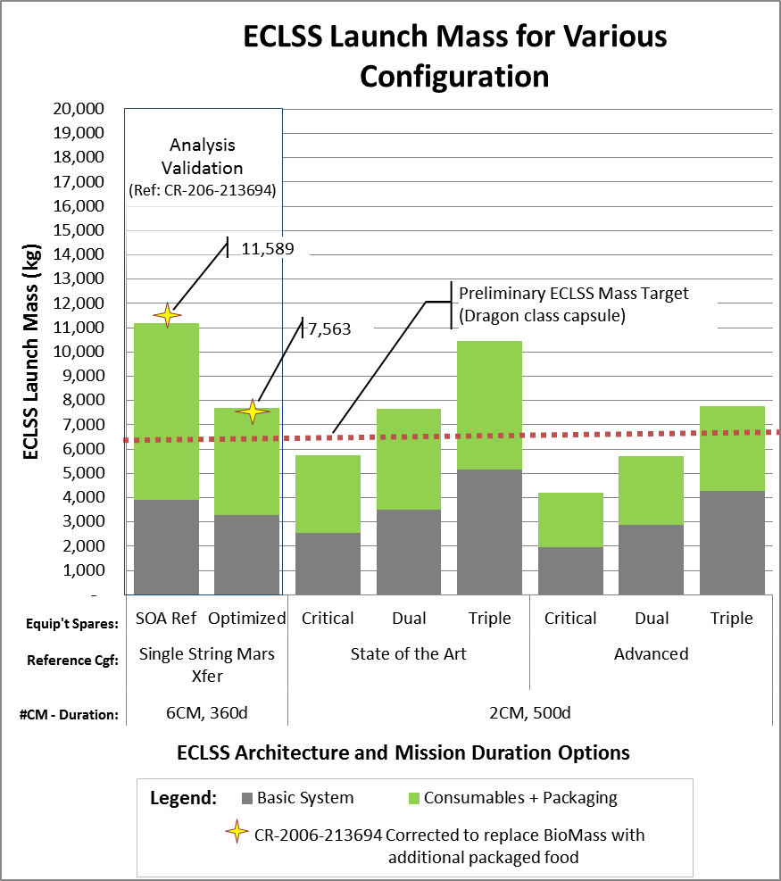
Volume/weight: Can we do this?

Slide 14
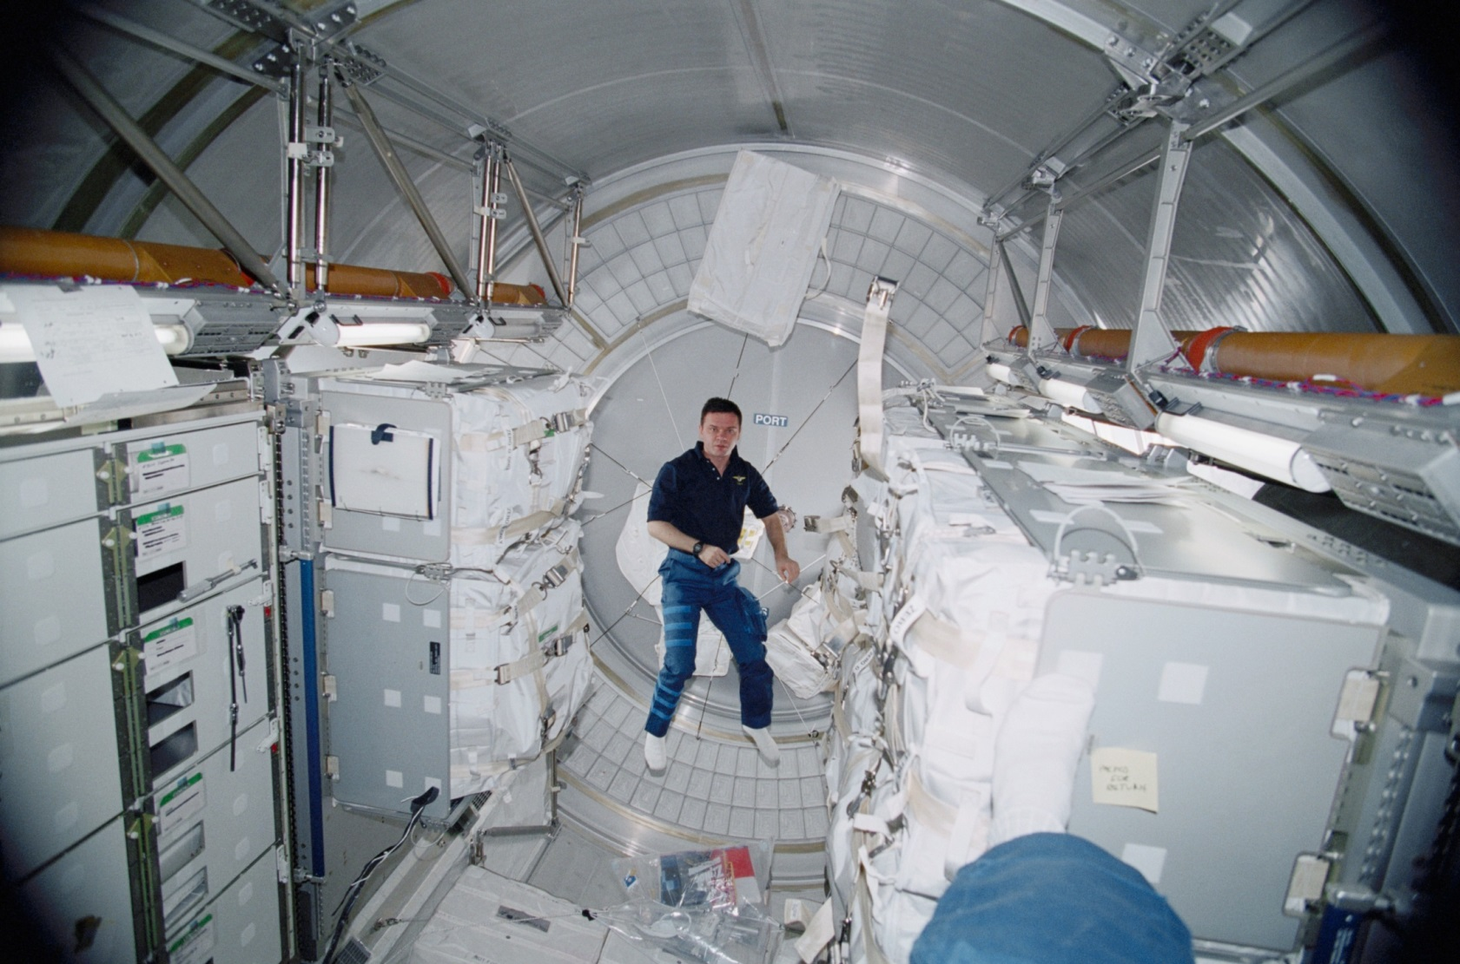
Inside Volume (MPLM example)

Slide 15
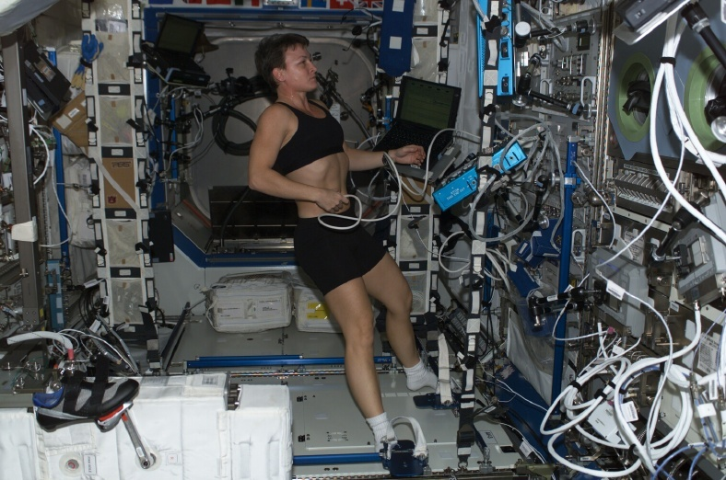
Inside Volume (Reality)

Slide 16
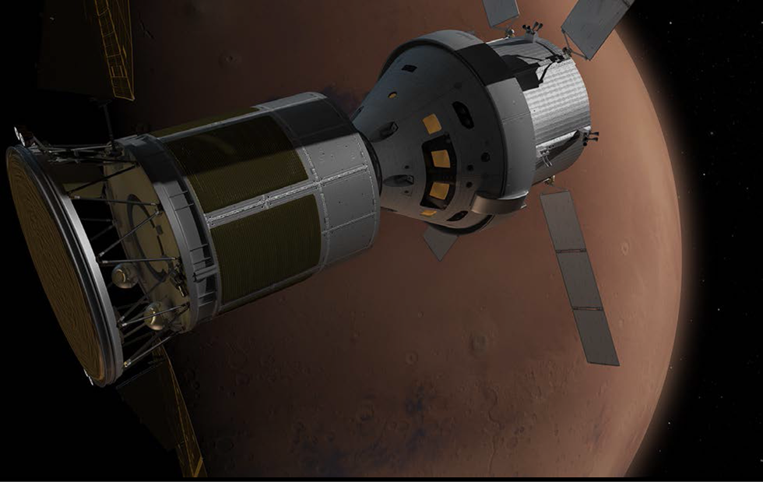
ECLSS Risks
Consumable usage
Atmosphere Leaks, Food conservation
Mechanical and Electrical Breakdown
Filters, Pumps, Controllers, Communications
Radiation
Galactic Cosmic Radiation (GCR), Solar Particle Events (SPE)
Crew Health
Exercise, Physical trauma, Disease, Mental

Slide 17
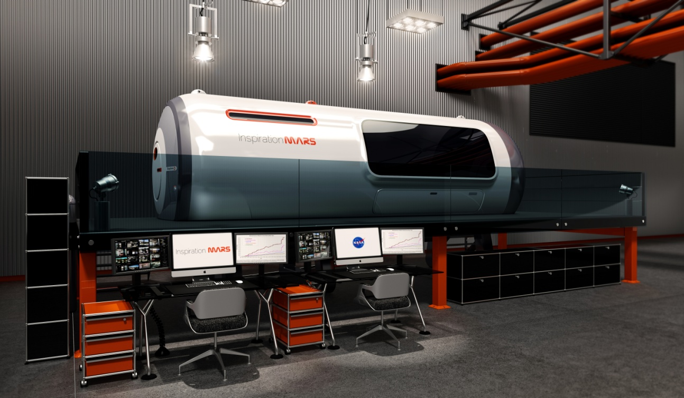
Ground Test Facility Concept for Life Support Testing

Slide 18
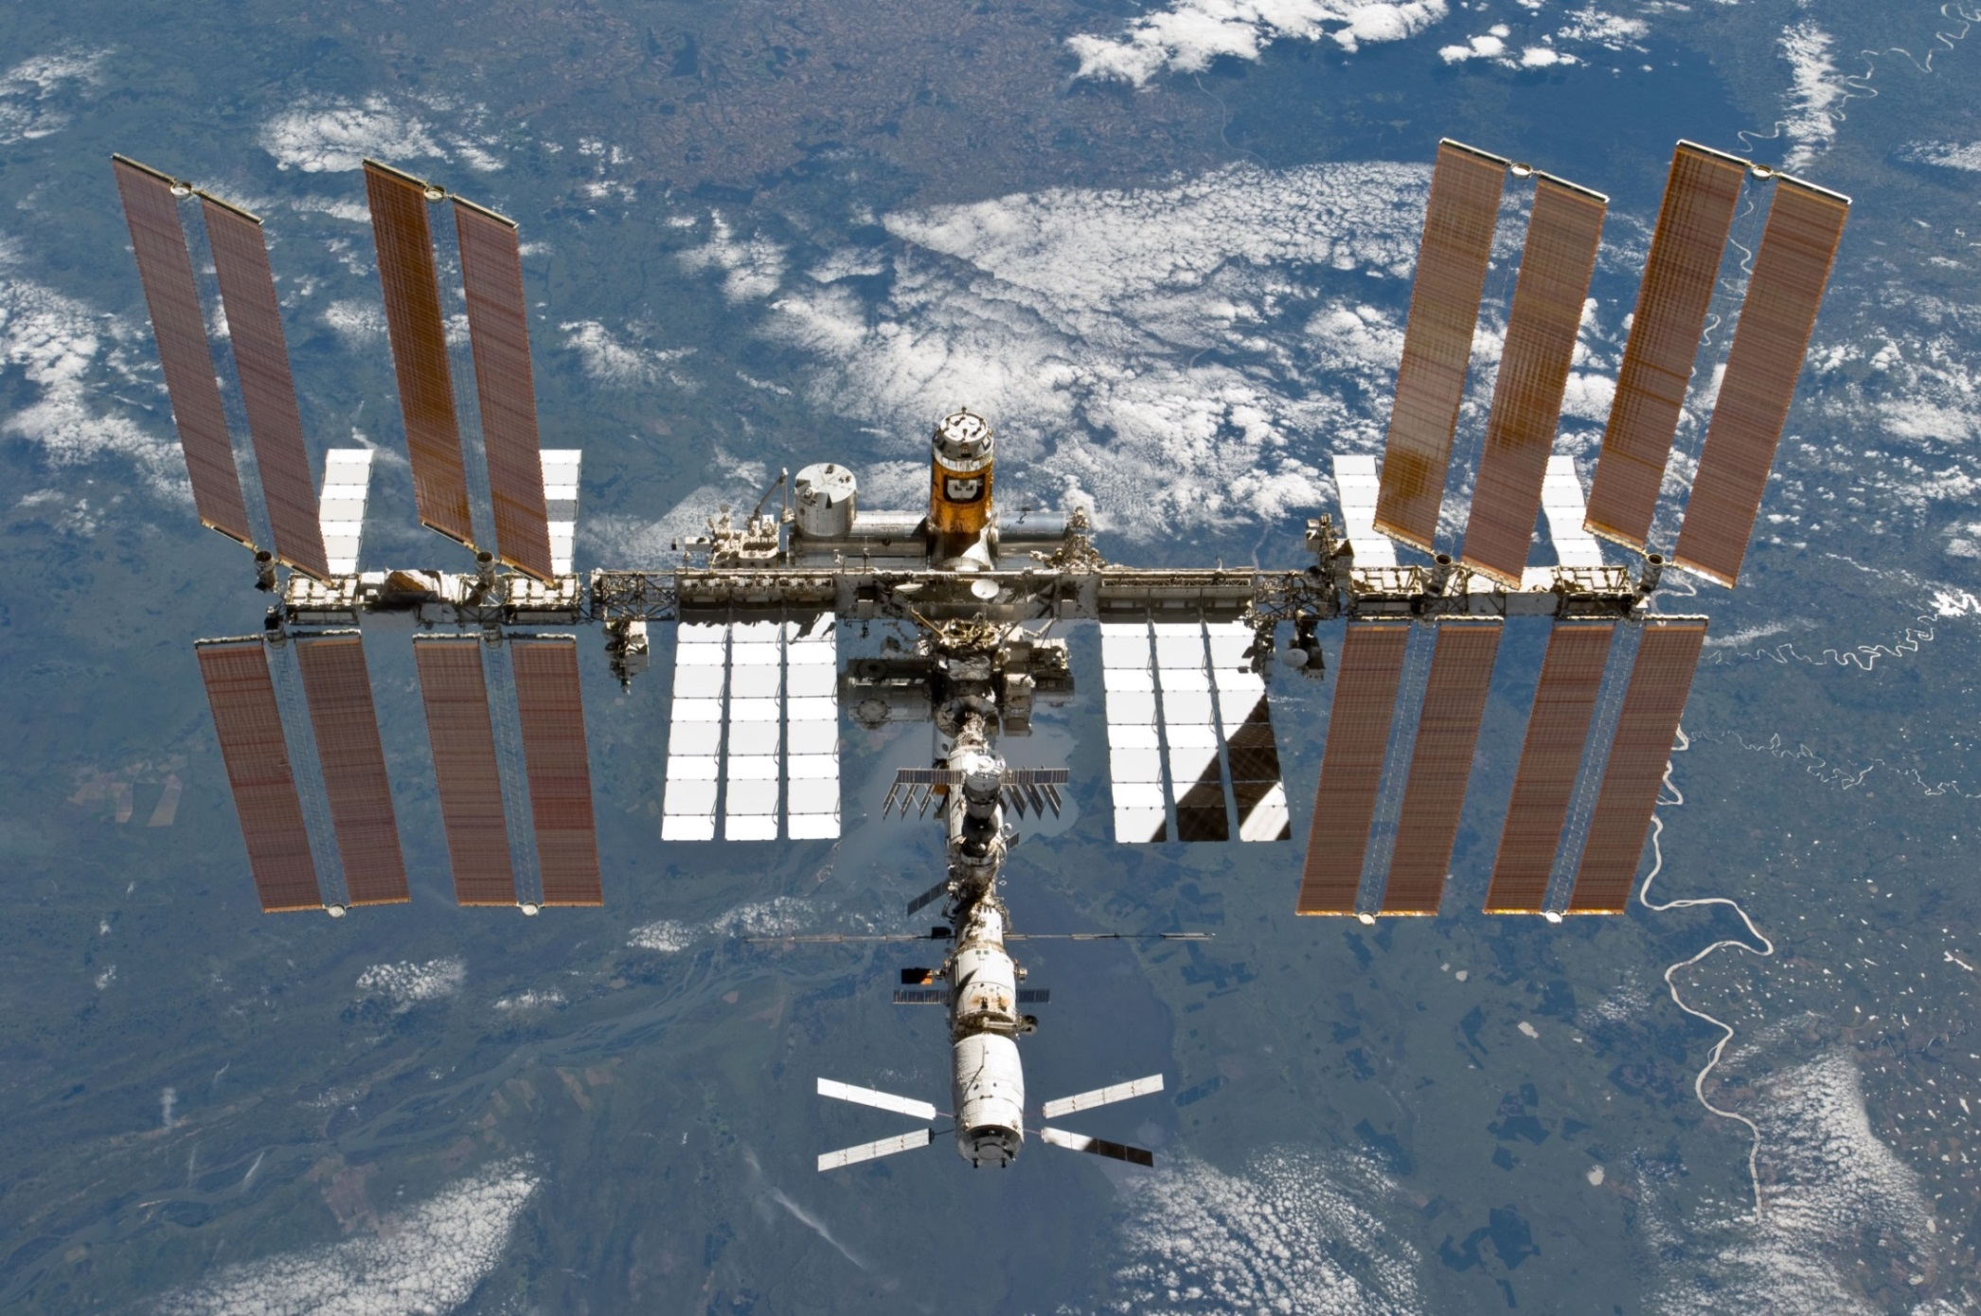
Flight (Micro-g) Support Testing

Slide 19
Summary
The technologies EXIST now.
It’s now about implementation, systems test and shake-out
ECLSS is a LONG DURATION test.
There is no way to accelerate testing. Biology does not lend itself to accelerated testing, Testing needs to start NOW….
ISS is an ideal laboratory for long-term micro-gravity testing.
Every ISS supply launch for the next 10 years should have an ECLSS test on it.
Questions/Comments?

Slide 20
Backup Slides

Slide 21


Slide 22
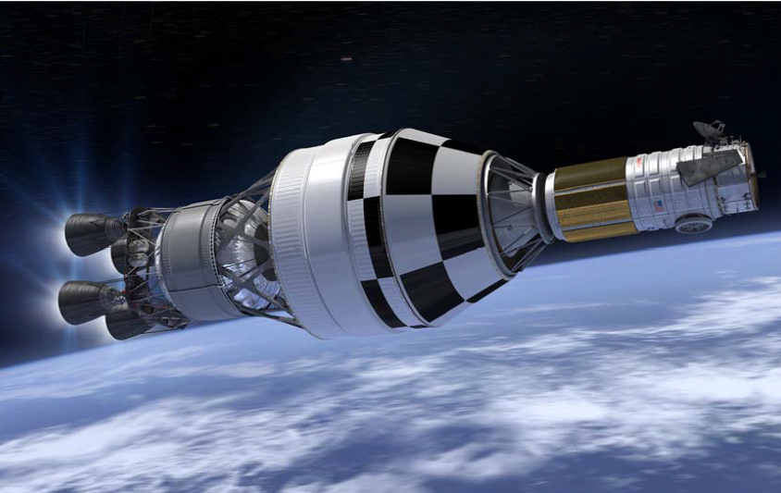

Slide 23
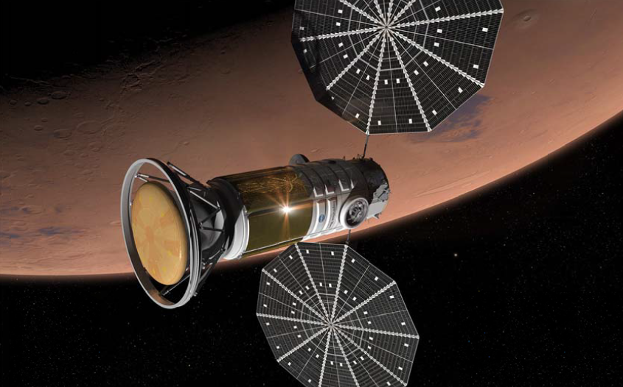

Slide 24
Risk | Health Threat/ Consequence
Radiation | Acute Radiation Effects (immune effects, nausea/ vomiting, cognitive performance deficits) Delayed Radiation Effects (cancer, cataracts)
Microgravity | Bone Loss/ fracture Cardiovascular deconditioning Muscle deconditioning/ weakness Visual Impairment/ Increased Intracranial Pressure
Isolated/ confined Environment | Behavioral dysfunction
Intravehicular Environment | Non viable or toxic atmosphere effects
Spontaneous Medical Events | Disease/ illness
Launch/ Ascent/ Reentry/ Landing Breakup | Trauma/ injury
Earth Reentry Gravitational Loads | Impaired cognitive and physical performance from orthostatic intolerance (cardiovascular deconditioning), sensorimotor dysfunction, and muscle weakness

